Slide 1

Final Project UART (Universal Asynchronous Receiver Transmitte)
By: Yusuf Ahmed Mohmed Abdelfadel
Supervised by: Mohamed Sayed

Slide 2
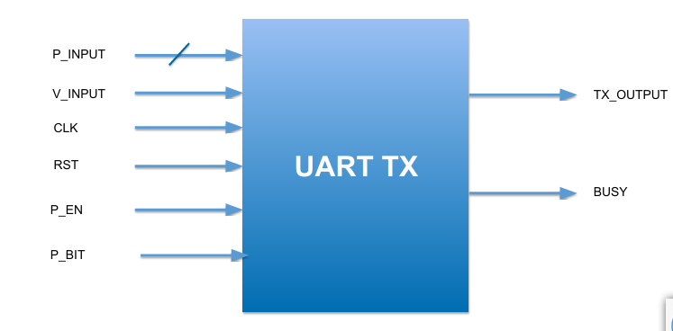
Project Overview
Project Overview The UART Transmitter (UART TX) is a digital RTL design that converts 8-bit parallel input data into a serial UART frame. The transmitter receives new data when the V_INPUT signal is high for one clock cycle and sends the complete frame through TX_OUT.
Main Features
8-bit parallel data input through P_DATA[7:0].
Serial data transmission through TX_OUT.
BUSY signal indicates that the transmitter is processing a frame.
Optional parity bit controlled by P_EN.
Even or Odd parity selected using P_BIT.
Asynchronous Active-Low Reset.
New data is not accepted while a frame is being transmitted.
Main Sub-Modules
1. Control (FSM) The main controller of the design. It manages the transmission sequence using five states: STEP0, STEP1, STEP2, STEP3, and STEP4.
2. Serializer Converts the 8-bit parallel input data into a serial bit stream and provides the data bits sequentially.
3. Parity Calculator Generates the parity bit according to the selected parity mode: Even or Odd.
4. MUX Selects the appropriate signal according to the current FSM state and sends it to TX_OUT.

Slide 3
Project Overview
UART Frame Structure START → DATA → OPTIONAL PARITY → STOP The TX_OUT line remains HIGH when the transmitter is idle.
FSM Sequence STEP0 → STEP1 → STEP2 → STEP3 → STEP4 → STEP0 STEP0: Beginning / Idle STEP1: Start Bit STEP2: Data Bits STEP3: Parity Bit STEP4: Stop Bit / End
Top Module Data Flow P_DATA → Serializer → serial_out ┐ P_DATA → Parity Calculator → parity_bit ├→ MUX → TX_OUT V_INPUT, P_EN → Control FSM → state ┘ Control FSM → BUSY, load_data, shift_en
Presentation Script "This is our UART TX Top Module. Its main purpose is to integrate the four main sub-modules of our design: the Control FSM, Serializer, Parity Calculator, and MUX. The input data is received through the 8-bit P_DATA bus when V_INPUT is high. The Control module manages the transmission process and generates the required control signals. The Serializer converts the parallel data into a serial bit stream, while the Parity Calculator generates the selected parity bit. Finally, the MUX selects the correct signal according to the current FSM state and sends it to TX_OUT. Therefore, the Top Module connects all sub-modules together to implement the complete UART Transmitter."
Key Design Concept Control = the brain of the design Serializer = converts parallel data to serial data Parity Calculator = generates the parity bit MUX = selects the transmitted signal Top Module = integrates and connects all four sub-modules

Slide 4
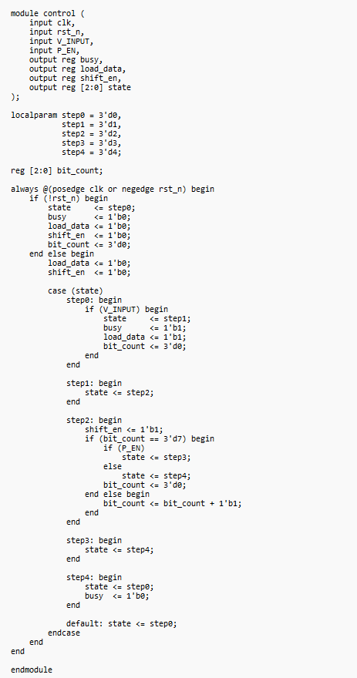
MAIN MODULES:
1.Main Controller
The Control Module is the main controller of the UART Transmitter. It manages the transmission sequence using a 5-state Finite State Machine (FSM).
State | Function
STEP0 | Initial / Idle state
STEP1 | Start bit
STEP2 | Data transmission
STEP3 | Parity bit
STEP4 | Stop bit / End

Slide 5
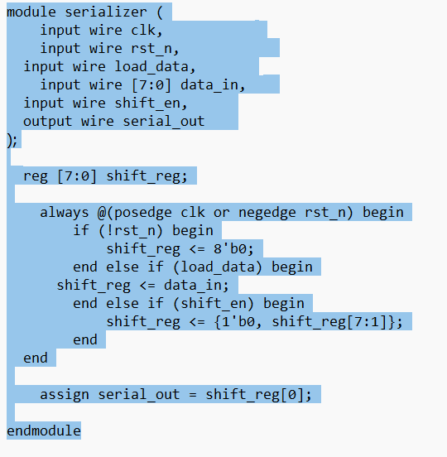
MAIN MODULES:
2• Serializer.
Loads the 8-bit input data into the shift register when load_data is enabled.
Sends the data serially, one bit per clock cycle.
Uses shift_en to control the shifting operation.
The register shifts right by one bit, while inserting 0 at the MSB.
serial_out is connected to shift_reg[0], which provides the transmitted bit.

Slide 6
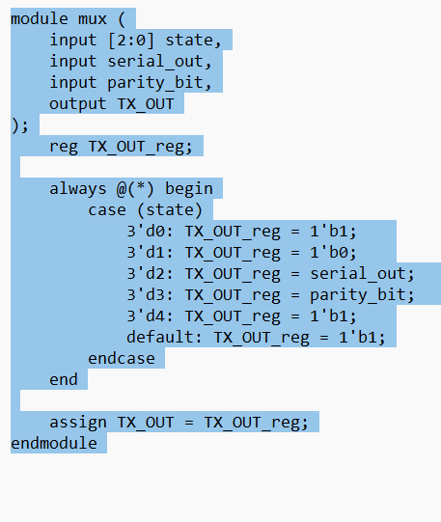
MAIN MODULES:
3• Mux
Selects the appropriate signal to be transmitted based on the current UART state.
Sends Logic 1 during the Idle and Stop states.
Sends Logic 0 during the Start state.
Passes the serialized data during the Data Transmission state.
Outputs the calculated Parity Bit when parity transmission is enabled.

Slide 7
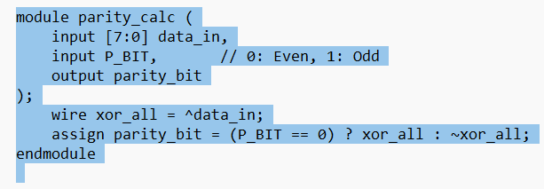
MAIN MODULES:
4• Parity bit calculator
Calculates the Parity Bit for the 8-bit transmitted data.
Uses XOR reduction to determine the parity of all data bits.
Supports both Even Parity and Odd Parity modes.
P_BIT = 0 selects Even Parity, while P_BIT = 1 selects Odd Parity.
The generated parity bit is sent along with the data to improve transmission error detection.

Slide 8
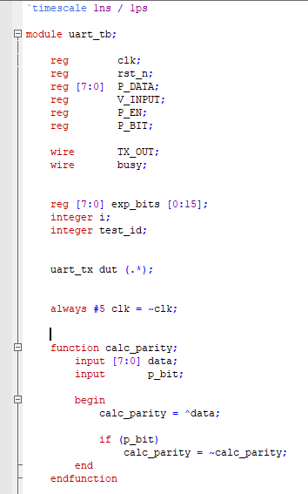
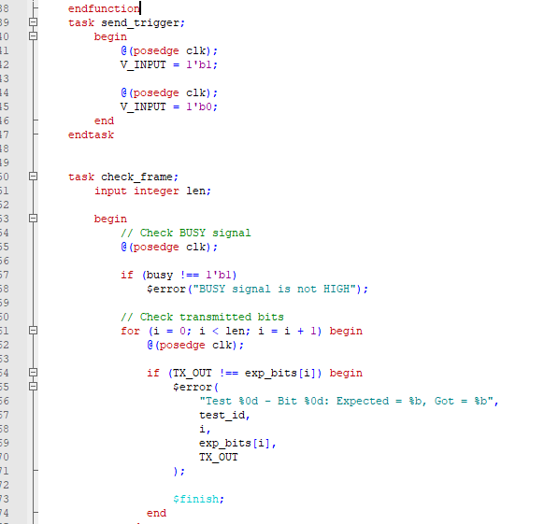
:UART Testbench
Generates the clock and reset signals.
Sends test data using the V_INPUT trigger.
Calculates the expected parity bit.
Checks the transmitted TX_OUT bits against the expected UART frame.
Verifies the BUSY signal during transmission.
Tests 3 cases:
No Parity
Even Parity
Odd Parity
Displays PASS/ERROR results for each test.
Task and Check transmitted bits

Slide 9
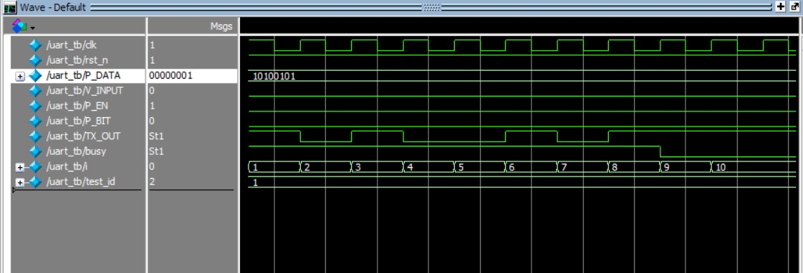
Wave form

Slide 10
Waveform Output
Signal | Value / Behavior | Description
CLK | Periodic | System clock for synchronization
rst_n | 0 to 1 | Reset is released and UART starts operating
P_DATA | 10100101 | 8-bit data to be transmitted
V_INPUT | Pulse | Triggers the transmission
P_EN | 1 | Parity is enabled
P_BIT | 0 | Even parity selected
TX_OUT | 0 → Data → Parity → 1 | Serial UART output
BUSY | 1 to 0 | High during transmission, low when finished

Slide 11
Thank you

